Slide 1
User Defined Function with LOGO! 0BA7

Slide 2
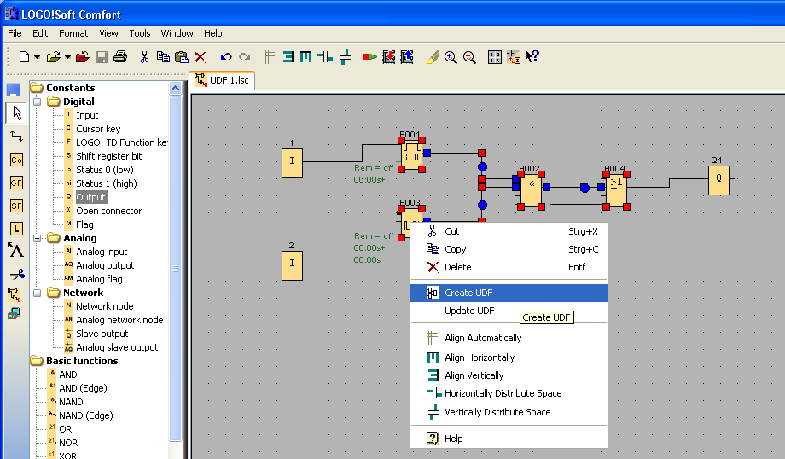
User Defined Function with LOGO! 0BA7
Select the part of the program you want in the UDF.
Press the right mouse button and select “Create UDF”

Slide 3
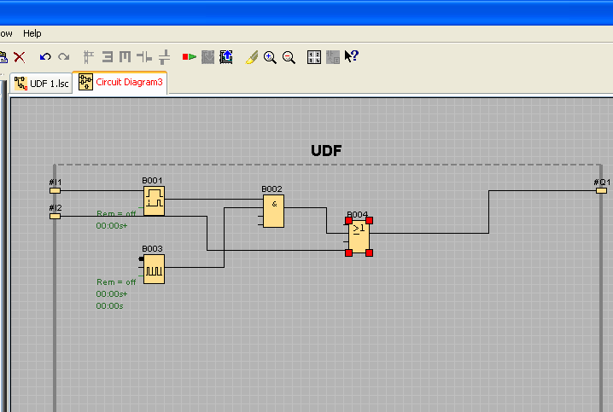
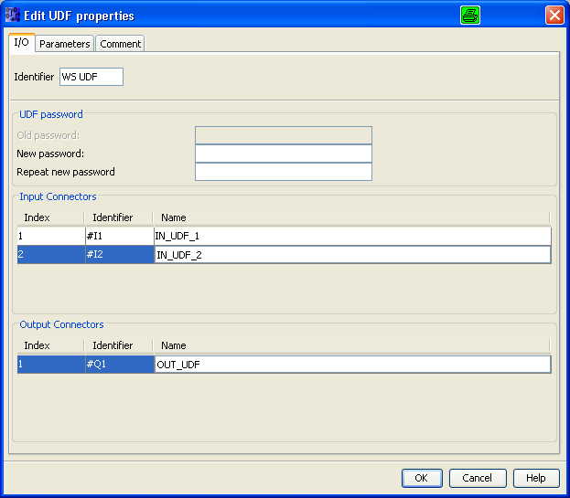
User Defined Function with LOGO! 0BA7
5
2
1
3
4
1
Press right mouse button and select Edit UDF Properties
4
Names of UDF In & Outputs
2
Specify a name
5
Change to tap Parameter and select the parameter you want to show or change
3
Password protection if needed
4
Names of UDF In & Outputs

Slide 4
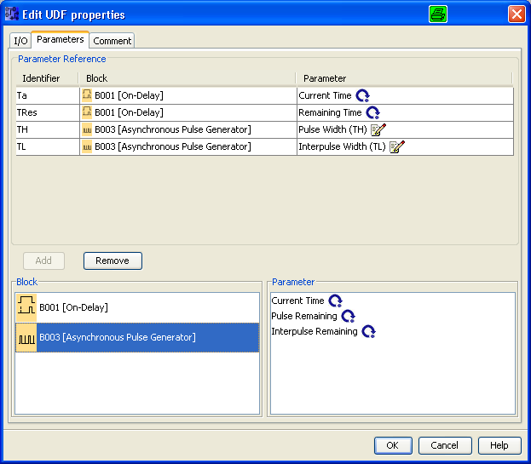
User Defined Function with LOGO! 0BA7
2
1
1
Select function block and parameter
2
Parameter Reference List of the UDF

Slide 5
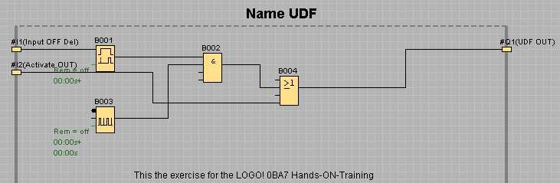
User Defined Function with LOGO! 0BA7

Slide 6
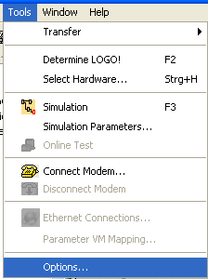
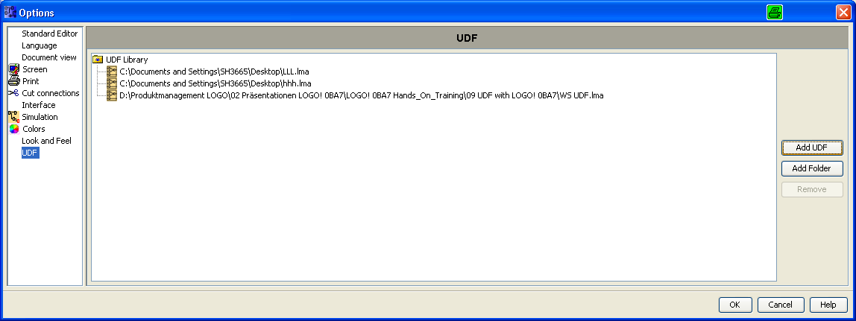
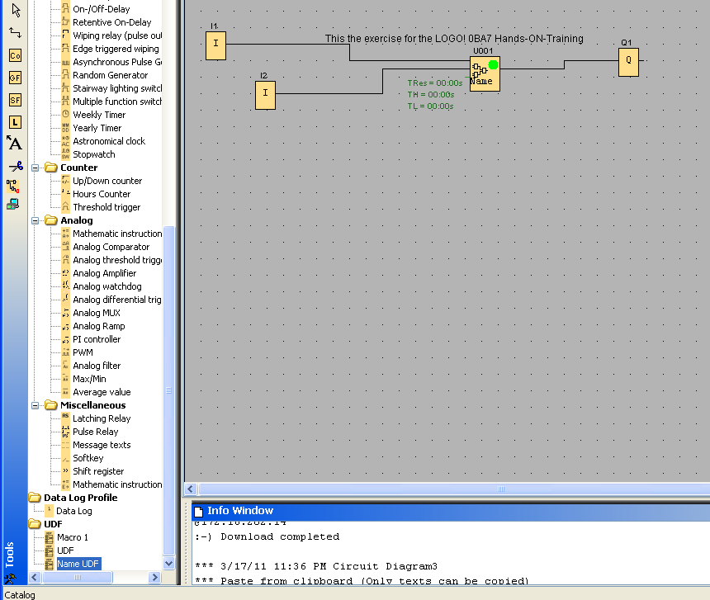
User Defined Function with LOGO! 0BA7
3
2
1
4
1
Select Tools; Options
2
In Options select UDF
3
Press Add UDF and brows to the location of the stored UDF
4
Place the UDF in a new project

Slide 7
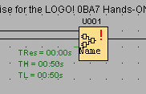
User Defined Function with LOGO! 0BA7
3
1
2
3
2
1
4
4
1
UDF Identifier
2
1
2
Specified parameter
Change UDF and save as new version
3
UDF Comments
4
UDF mark

Slide 8
Networking wiht LOGO! 0BA7 V1
Thank you for your attention!
H. Schindler
I IA AS FA PS4
Phone: ++49 (0)911 / 895 - 3665
E-Mail: Helmut.schindler@siemens.com

